Slide 1
Sign Language Interpreter
BY Ayaan Amin Shaikh
Seat No - 3005605
Roll no - 25

Slide 2
INTRODUCTION
Sign language is manual communication commonly used by people who are deaf. Sign language is not universal; people who are deaf from different countries speak different sign languages. The gestures or symbols in sign language are organized in a linguistic way. Each individual gesture is called a sign. Each sign has three distinct parts: the handshape, the position of the hands, and the movement of the hands. Indian Sign Language (ISL) is the most commonly used sign language in the India .
Although signing is used primarily by the deaf and hard of hearing , it is also used by hearing individuals, such as those unable to physically speak, those who have trouble with oral language due to a disability or condition
It detects the gestures and converts it into text

Slide 3
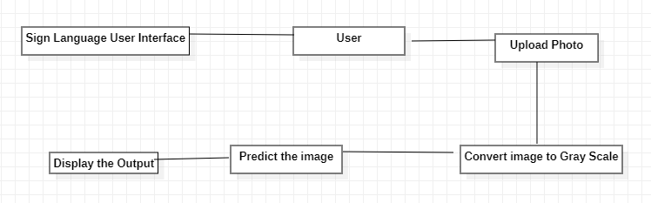
SYSTEM ARCHITECTURE

Slide 4
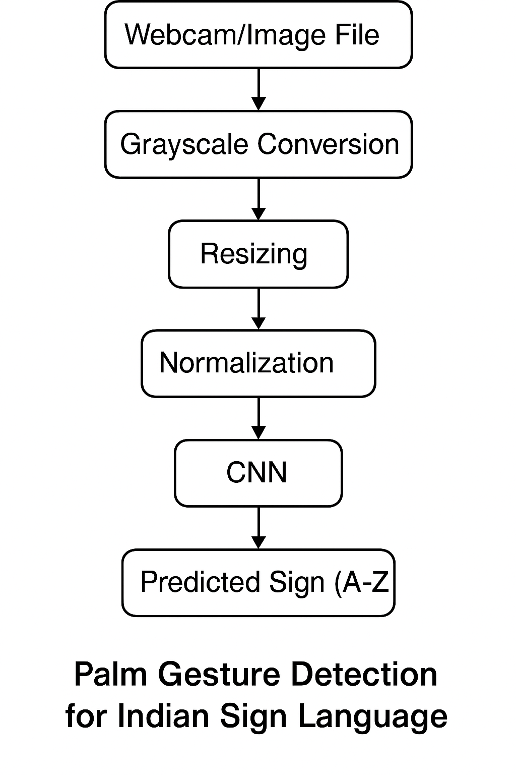
FLOW DAIGRAM

Slide 5


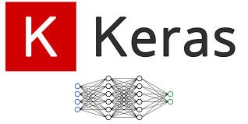
TOOLS & TECHNOLOGIES

Slide 6
TOOLS & TECHNOLOGIES
Keras is an open-source deep learning library written in Python. It provides a high-level, user-friendly interface for building and training deep learning models. Initially developed as an independent project, Keras is now fully integrated into TensorFlow as its official high-level API, making it accessible and powerful for both beginners and advanced users.

Slide 7
TOOLS & TECHNOLOGIES
OpenCV (Open Source Computer Vision Library) is an open-source library primarily focused on real-time computer vision and image processing. It was developed by Intel and has become one of the most popular libraries for vision-based applications.
With OpenCV, you can perform a variety of tasks such as:
Reading, writing, and displaying images and videos
Image filtering and transformation (e.g., grayscale, blur, edge detection)
Object and face detection

Slide 8
ADVANTAGES OF SIGN LANGUGE
Accessibility for Deaf and Hard of Hearing Individuals: - Signed languages provide a natural and effective means of communication for those who are deaf or hard of hearing, allowing them to express themselves fully.
Visual Communication: - Signed languages utilize visual-spatial modalities, which can enhance understanding through gestures, facial expressions, and body language.
Cultural Identity: - Signed languages are often deeply tied to the cultural identity of the Deaf community, fostering a sense of belonging and shared experience
Immediate Communication: - In environments where sound is not practical (e.g., loud settings or quiet spaces), signed languages allow for effective communication without the need for vocalization.

Slide 9
LIMITATIONS OF SIGN LANGUGE
Limited Reach: - Signed languages may not be understood by hearing individuals who do not know the language, potentially leading to communication barriers.
Variability: - Different regions may have different signed languages or dialects, which can create challenges for communication across different communities.
Learning Curve: - For those who are not familiar with signed languages, there can be a steep learning curve, requiring time and practice to become proficient.
Limited Resources: - In some areas, there may be fewer educational resources, interpreters, or materials available for learning signed languages compared to spoken languages.
Misconceptions: - There are often misconceptions about signed languages being simply gestures or miming, which can undermine their complexity and richness as fully developed languages.

Slide 10
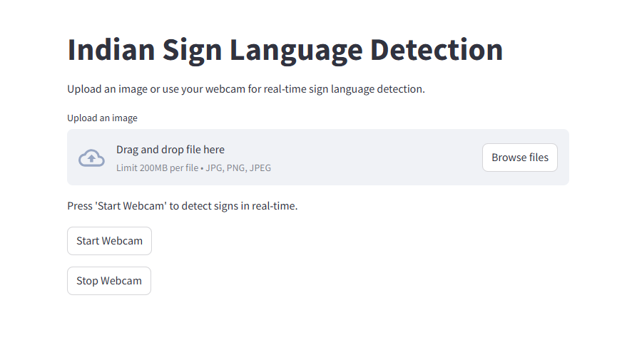
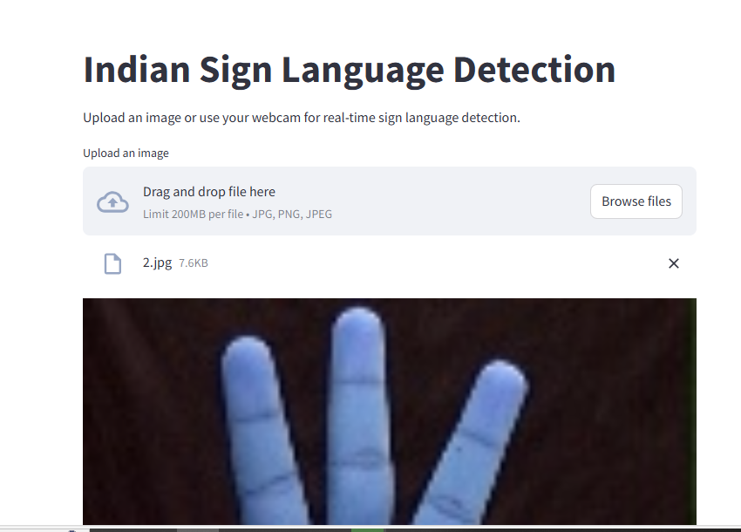
RESULTS

Slide 11
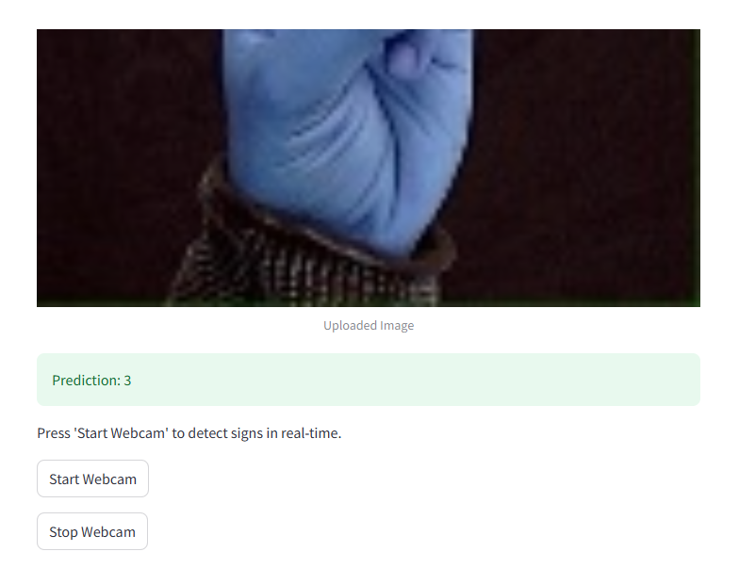

Slide 12
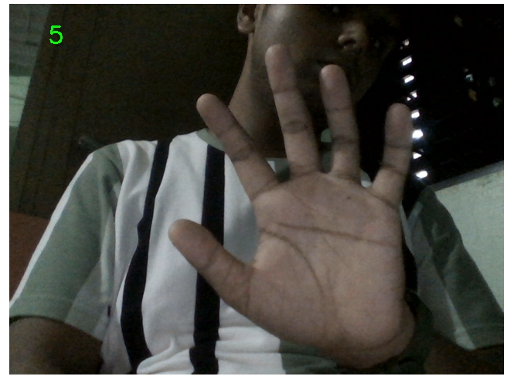
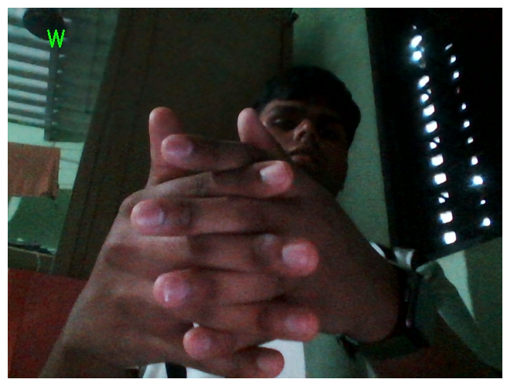
RESULTS FOR LIVE PREDICTION USNG WEBCAM

Slide 13
REFERENCES
https://youtu.be/kIOTtRf9Drk?si=BHOmCA-ktHxiBZa4 – R&D.
https://youtu.be/zC22yPmc6Kw?si=or5Ibzw5H9_dBAbd – Ghantt Chart.
E-Commerce strategy methodology development and implementation | Systems Design Engineering | University of Waterloo (uwaterloo.ca) – Methodology
https://en.wikipedia.org/wiki/Sign_language – Introduction.
How to Write An effective Project Objective, With Examples [2024] • Asana Objectives.
https://www.quora.com/What-are-the-advantages-and-disadvantages-of-a-signed-language - Advantages & limitations.
https://www.w3schools.com/python/python_intro.asp – Python.
Bridging Tech Gaps with Technology Surveys (voxco.com) – Survey of Technology.
UML models and diagrams - IBM Documentation – System Design.
Software Testing - Implementation Testing (tutorialspoint.com) – Implementation & Testing.
System Analysis and Design - Overview (tutorialspoint.com) – System Analysis and Design.

Slide 14
THANK YOU !!!

